Slide 1
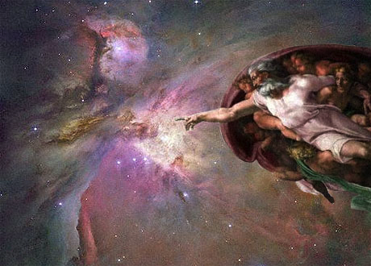
Arguments for God’s Existence
Professor Rob Koons
Philosophy – University of Texas
robkoons@yahoo.com
robkoons.net (temp. down)

Slide 2
Evidence that the Universe (Space, Time and Matter) had a Supernatural Cause
Philosophical arguments
The Thomistic argument: whatever is contingent has a causal explanation.
The Kalaam argument: time had a beginning.
Scientific evidence:
Evidence for the “Big Bang”
Evidence for the fine-tuning of our universe for life

Slide 3
Proving God’s Existence
What follows will be based on Ways 1-3 of St. Thomas Aquinas’s Summa Theologica I 2 a3, and his much longer Summa Contra Gentiles:
http://www.newadvent.org/summa
http://www2.nd.edu/Departments/Maritain/etext/gc.htm
By Alexander Pruss, at Baylor: The Principle of Sufficient Reason (Cambridge Univ. Press, 2010).
Pruss and Rasmussen, Necessary Existence (2018)
Also, some of my own work, including “A New Kalam Argument”, Noûs 2013, and (with Pruss), “The Principle of Sufficient Reason and Skepticism, Philosophical Studies 2020.

Slide 4
An Argument with a Long History
Accepted by philosophers from six great traditions:
Ancient pagan (Greek and Roman)
Jewish
Christian
Moslem
Indian (10th century Nyaya school)
Early modern European
Developed over 2500 years.

Slide 5
What do we know?
Hold out your right hand, and spread out your fingers.
Do you know that there is a hand with five fingers in front of you?
If so, you can also know that God exists

Slide 6
Empirical Knowledge
Your knowledge of your hand and its fingers is a case of ‘empirical knowledge’:
Things we know by observation (using the five senses)
Things we know by memory (remembering what we have observed)
Things we know by the testimony of others
Things we can infer from these by scientific or historical reasoning

Slide 7
Empirical Knowledge Depends on “Causality” (Cause and Effect)
When we know something empirically, our belief is linked by a chain of cause and effect to the thing we know.
Sensory perception involves a chain of cause and effect (e.g., light reflection, retinal stimulation)
Memory involves a chain of causes in the brain, recording and recalling a memory trace
Testimony is passed down a chain of communication events
Scientific and historical reasoning infers causes from effects or effects from causes.

Slide 8
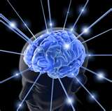
Causal Chain
If any of these steps could occur without a cause, knowledge would be impossible.

Slide 9
Does everything have a cause?
Everything involved as a link in the chain of empirical knowledge must have a cause.
Suppose, for example, that sensations could occur without any cause whatsoever.
If that were ever possible, it would be possible all the time, and with a completely unpredictable and inscrutable probability.
We would have good reason to think that we might be “Boltzmann brains” right now – with nothing but illusory sensations.

Slide 10
Universal Causality must be Self-Evident
We supposed that we did have some empirical knowledge (remember the five fingers).
But such knowledge is impossible unless we know that every step involved (before the last one) necessarily has a cause.
We can’t know that empirically (without vicious circularity), so it must be a self-evident principle of reason.

Slide 11
The Only Possible Stopping Point
There is one sort of thing that could fail to be caused, without threatening empirical knowledge: things that are obviously uncausable.
Not just uncaused but self-evidently uncausable.

Slide 12
The Universal Causation Principle
Let’s say that something is ‘natural’ just in case it isn’t obviously uncausable.
Reason tells us, with certainty:
Every natural thing must have a cause.

Slide 13
Second Proof
The Kalam Argument
The universe (the totality of things in time, things with causes) had a beginning.
Everything that had a beginning had a cause.
Therefore, the universe as a whole had a cause.

Slide 14
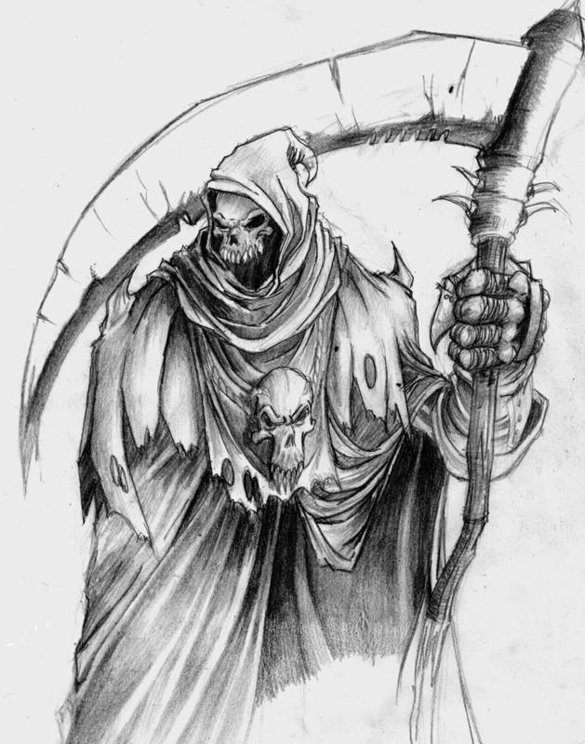
The Grim Reaper Jose Benardete’s Infinity: An Essay in Metaphysics (1964)
Death to Fred!

Slide 15
Death to Fred!
Death to Fred!
12:00:30
12:01
12:00:15
12:00:07.5
12:00:03.75
12:00:01.875

Slide 16
The Unbounded Version
1 B.C.: GR #1
2 B.C: GR #2
3 B.C.: GR #3
etc.
Each Grim Reaper issues a death warrant for Fred if and only if no preceding GR has done so.
(Invented by Prof. Pruss at Baylor, 2009.)

Slide 17
Story leads to a Contradiction
At least one GR has initiated a death warrant, since otherwise all would have failed to do their duty. Say it was GR #n
GR #n would have acted only if all earlier GR’s did not act. So, both GR #(n+1) and GR#(n+2) did not act.
But, if GR#(n+2) and all earlier GRs did not act, then GR#(n+1) would have acted. Contradiction.

Slide 18
Reductio ad Absurdum
If a contradiction follows logically from a proposition, then that proposition must be false.
The GR story follows from the proposition that an infinite regress is possible, and the GR story is self-contradictory.
Therefore, an infinite causal regress must be impossible.

Slide 19
Another argument for a First Cause
Even if infinite regresses were possible, they would have to have a cause as well. The Gale-Pruss cannonball argument.
Let the Cosmos = the sum of all natural (variable, contingent) facts. The Cosmos will itself be contingent, so it comes under the Principle of Causation.
The cause of the Cosmos must be separate from it – and so must be infinite and necessary. (This argument is from al-Farabi, Duns Scotus, and Gottfried Leibniz)

Slide 20
Existence of a First Cause
If the network of causation contains no loops and no infinite regresses, then there must exist at least one uncaused or “First” cause.
However, we have seen that empirical knowledge requires that every evidentially proximate thing must be caused.
So, any First Cause must be evidentially ultimate: obviously (self-evidently) incapable of being evidence for anything else, i.e., uncausable.

Slide 21
What must Ultimate things be like?
What characterizes all causable things? (E.g., things we perceive or remember, things that are intermediate between perceptions and objects, things that can be used as scientific data)
They are all (obviously) variable, inconstant, changing.
So, an uncausable or ultimate thing (a First Cause) must be invariant, constant, unchangeable.

Slide 22
Nature of the First Cause
Uncausable
Infinite
Absolute Existence

Slide 23
From First Cause to Absolute Being
In order to be uncaused, the First Cause must be necessary (constant and invariant).
In order to be necessary, the FC must be infinite in every respect, because what is finite is variable.
In order to be necessary in itself, the FC must be simple or absolute Existence, since if it were not, it would be limited or bounded in some way, and so finite.

Slide 24
From Absolute Being to One God
There could be only one thing that is identical to Absolute Existence, because if there were two, they’d be identical to each other.
This being must have all possible power, since it must be the cause of all possible beings.
In order to have all possible power, it would have to possess all positive attributes to their absolute maximum degree: perfect knowledge, beauty, wisdom, goodness, etc.

Slide 25
The Big Bang
A Belgian priest, Father Georges Lemaitre, was the first to discover that Einstein’s theory of general relativity entailed that the universe had a beginning (1930’s).
Fiercely resisted by most astronomers (as documented by Robert Jastrow’s God and the Astronomers) for being “too theological.”

Slide 26
Proof of the Big Bang
Astronomer Edwin Hubble observed the ‘red shift’ of distant galaxies.
Confirmed in the 1960’s with the observation of the ‘cosmic background radiation’, leftover from the Big Bang.
Universally agreed upon: time, space and matter began 13.7 billion years ago.
What begins to exist has a cause.

Slide 27
Before the Big Bang?
In recent years, some physicists have proposed theories of a pre-Big-Bang era (infinite inflation or string/brane theories).
2003 theorem by Borde, Guth and Vilenkin: every inflationary model universe (with or without a multiverse) must have a beginning in time.

Slide 28
Design Argument
We can infer that the First Cause is infinitely wise and personal by examining the creation.
The creation is obviously organized for certain purposes: it obeys simple, universal laws, it permits the origin and development of life, it contains human beings, with the capacity for universal knowledge.

Slide 29
Evidence of Design: Overview
Simple, elegant laws of nature.
Anthropic fine-tuning. The constants of nature, the ratios of fundamental forces are adjusted to permit the formation of carbon, planets.

Slide 30
Evidence of Design
The design of the earth, as an ideal environment for life, intelligence, astronomy: Guillermo Gonzalez, The Privileged Planet.

Slide 31
More evidence
The origin of life (within a few million years of the formation of liquid water).
The DNA code, that couldn’t have formed by chance.

Slide 32
Some Anthropic Coincidences
Seven coincidences (of about 40):
#1: Strong nuclear force.
If 5% weaker, no deuterium formed at Big Bang. Deuterium needed for initial ignition of fusion in stars.
If 50% weaker, all elements would be unstable (equivalently, if electromagnetic force were 14X stronger)

Slide 33
Anthropic Coincidence #2
Cosmological constant must be close to zero (less than 10 to the minus 50th power), but positive.
If too strong, inflation proceeds to far, leading to a diffuse cloud.
If too weak, inflation cannot take place at all, leading to a lumpy, non-uniform cosmos, preventing the formation of stable stars and galaxies.

Slide 34
Anthropic Coincidence #3
Net electrical neutrality of universe. The number of protons and electrons (produced by two independent processes in Big Bang), must agree to within a factor of 10 to the 37th power.
Otherwise, electrical repulsion would overwhelm gravity, preventing the formation of galaxies, stars, planets.

Slide 35
Anthropic Coincidence #4
The coordination of several atomic resonance levels in carbon. If the third resonance had been 1/2% higher, no carbon would have been produced.
“A common sense interpretation of the facts suggests that a superintellect has monkeyed with physics…that there are no blind forces in nature.” Astronomer Fred Hoyle

Slide 36
Anthropic Coincidence #5
Electromagnetic force (compared to gravity).
If too weak, all stars would be short-lived blue dwarfs. Gravity is weaker by a factor of 10 to the 39th power. If gravity were 3000 times greater, no long-lived stars.
1 part in 10 to the 36th power.

Slide 37
Anthropic Coincidence #6
Visible light, 0.3 to 1.5 microns, (produced in abundance by Sun-like stars) has exactly the right energy levels to interact usefully with chemical reactions (almost all chemical reactions involve energy corresponding to the 0.32-0.8 micron range).
Too little - passes right through matter (like radio and microwave).
Too much -- destroys compounds (X-rays, gamma rays).
Visible light is 1 part in 10 to the 25th power of the whole spectrum.

Slide 38
Anthropic Coincidence #7
The universe began in a state of extremely low entropy.
Roger Penrose: odds of 1 in 10 to the 10 to the 123rd power. More zeros than there are atoms in the universe!
If the Big Bang were merely a transition from some earlier state, then there would be no possible explanation for its low-entropy state.

Slide 39
The One-Two Punch
To summarize tonight’s lecture, we have a convergence of arguments for the conclusion that the universe has a supernatural cause:
From metaphysics – the First Cause arguments.
From physics – the Big Bang and fine tuning.
The two together are much stronger than either separately. Physics makes God’s existence probable, metaphysics makes it certain.

Slide 40
Best Scientific Evidence for God
Is science itself!
Every new scientific discovery confirms the existence of God.

Slide 41
Role of Christianity
Without the faith in the rational intelligibility of the world and the divine vocation of human beings to master it, modern science would never have been possible:
Alfred North Whitehead, Science and the Modern World,
Joseph Needham, The Great Titration: Science and Society in East and West

Slide 42
Seven theological preconditions for science
The belief in the intelligibility of the universe, as the artifact of a perfect Mind, working with suitable material that it has created.
The closely connected Hebraic conception of God as a law-giver.
The idea of a “law of nature” was introduced by Christian theologian Basil of Caesarea (329-379), The Six Days.

Slide 43
Seven theological preconditions
2. A belief in the fitness of the human mind, created in the image of God, to the task of science, conceived of as a vocation given by God.
3. The need for observation and experiment to discover how in fact God has exercised His freedom and omnipotence in creating.

Slide 44
Seven theological preconditions
4. The disenchantment of the world by theism, clearing away the many gods of polytheism and animism.
5. The conception of nature as
a divine “book”, parallel to the Bible.

Slide 45
Seven Theological Preconditions
6. The linear view of time. The possibility of progress.
7. The dignity of matter and of manual work, a consequence of the theological doctrine of the Incarnation (Jesus as God in human form), especially given Jesus’ occupation as a carpenter or stone cutter.

Slide 46
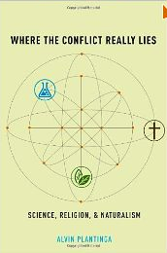
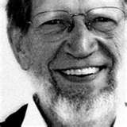
Alvin Plantinga

Slide 47
Alvin Plantinga
Chapter 10 of Where the Conflict Really Lies (2011).
Demonstrates that materialism, without a Designer who intended man to be equipped with an aptitude for truth, leads inexorably to a catastrophe, the “defeat” of all the materialist’s aspirations for knowledge

Slide 48
The materialist’s quandary
Lacking any explanation for his reliability, other than appeal to dumb luck, the materialist occupies a position that is untenable for the purposes of asserting claims to scientific knowledge.

Slide 49
Science vs. Materialism
Materialism, therefore, can draw no support whatsoever from modern science, since scientific realism entails that materialism is false.
If scientific theories are treated as mere useful fictions, science would have no bearing on the truth or falsity of materialism at all.

Slide 50
Science supports theism
By contrast, theists can point to the success of science as the confirmation of their metaphysical position, the verification of a daring prediction made by theists hundreds of years ago.

Slide 51
Summing Up
Belief in God is confirmed by both philosophical argument (First Cause) and scientific evidence (Big Bang, fine tuning).
Theism is a practical presupposition of science itself. All scientific success confirms its truth.

